Slide 1

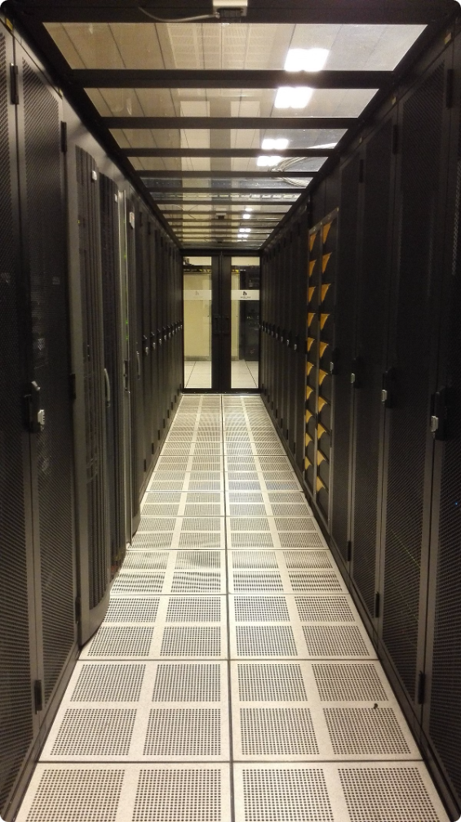


DDoS Protection in the Cloud
Distributed denial-of-service (DDoS) attacks are a significant threat to online services. Cloud environments offer unique challenges for DDoS protection.
by Anju Dhindhwal

Slide 2


Challenges of DDoS Protection in Cloud Infrastructures
1
Scalability
2
Shared Resources
Cloud environments can rapidly scale up or down, making it difficult to dynamically adjust DDoS defenses.
Cloud providers share resources among tenants, making it challenging to isolate attacks and protect individual customers.
3
Network Complexity
4
Rapid Attack Evolution
Cloud networks are highly complex, requiring sophisticated tools and techniques to effectively identify and mitigate DDoS attacks.
DDoS attacks are constantly evolving, requiring cloud providers to adapt their defense strategies.

Slide 3
Architectural Principles for DDoS Protection in the Cloud
Distributed Defense
Layered Defense
Intelligent Routing
Distributing DDoS protection across multiple points in the cloud network can help mitigate attacks more effectively.
A layered approach combines different defense mechanisms, such as rate limiting, traffic filtering, and anomaly detection.
Dynamically routing traffic around malicious sources can prevent attackers from overwhelming critical systems.

Slide 4

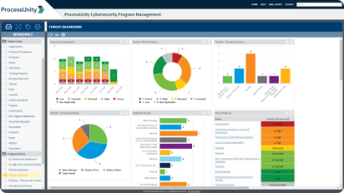



Monitoring and Detection Mechanisms
Real-Time Traffic Analysis
Continuous monitoring of network traffic patterns can identify anomalies indicative of DDoS attacks.
Behavioral Analysis
Analyzing user behavior can help distinguish legitimate traffic from malicious activity.
Threat Intelligence
Leveraging threat intelligence feeds can provide insights into known DDoS attack patterns and techniques.

Slide 5


Mitigation Strategies and Techniques
Rate Limiting
Restricting the rate of incoming requests from specific sources.
Traffic Filtering
Blocking traffic from known malicious sources.
Challenge-Response
Requiring attackers to solve puzzles to prove they are not bots.
Blackholing
Dropping traffic from malicious sources completely.

Slide 6


Integrating DDoS Protection with Cloud Services
1
Load Balancing
Distributing traffic across multiple servers to prevent overload.
2
Content Delivery Networks (CDNs)
Caching content closer to users to reduce server load.
3
Security Information and Event Management (SIEM)
Centralized logging and analysis of security events for better threat detection.

Slide 7

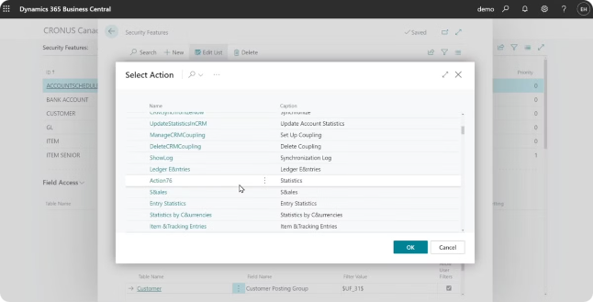
Selecting the Right DDoS Protection Tools and Solutions
Cloud-Native Solutions
Hardware-Based Appliances
Integrated with cloud platforms for seamless deployment and management.
High-performance devices for large-scale DDoS mitigation.
Managed Security Services (MSS)
Outsourcing DDoS protection to specialized security providers.

Slide 8






Best Practices and Recommendations
Proactive Monitoring
Regular Testing
Continuously monitor network traffic for early detection of DDoS attacks.
Conduct regular DDoS simulations to ensure the effectiveness of mitigation strategies.
Security Training
Collaboration with Cloud Providers
Educate staff on DDoS threats and best practices for preventing attacks.
Work closely with cloud providers to leverage their DDoS protection capabilities.

